Slide 1


Advanced Learning Academy of Wisconsin
“ALAW”
CONNECTIONS LEARNING
Learning as Unique as You.

Slide 2

Welcome to ALAW!
Today we will:
Spend some time becoming familiar with the tools, teachers and feel of Virtual Schooling!
Answer frequently asked questions about Connections Learning courses
Give an overview of the Learning Management
System “Connexus”
Explain how to get in contact with us at ALAW

Slide 3








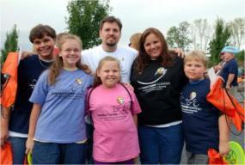
What is a virtual school?
Curriculum
Materials
Learning
Coach
Student
Teacher
Community
Notes:
In this slide, the main point is to describe what a virtual school is.
Your student learns outside the traditional classroom, supported by:
Involved family: Parent learning coaches monitor day-to-day activity.
Certified teachers who work from a school building (or hub) and who care about your student’s success. They communicate with you and your student online, by phone, by mail.
And we send you all the materials you need to succeed including Quality curriculum built from the best resources available to meet all state standards.
Innovative technological tools enhance learning and social interaction with our community of Connections Academy families.
Emphasize that the student is supported by all of these elements, which contribute to his or her success.

Slide 4

Connections Learning and ALAW
“We connect kids with their potential.”

Slide 5

Connections Learning
Full-time and blended options through the Barron Area School District
Primary provider for grades K-6
Secondary provider for grades 7-12
Available to all Wisconsin students
Wisconsin-licensed teachers
Tuition Free
Dedicated to student success in school…and in life
Notes:
In this slide, provide specific school details including grades, eligibility, the fact that it’s part of a proven program and network of schools nationwide, and emphasize that it’s tuition free.

Slide 6
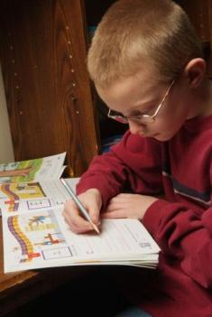
Our Elementary School Program
Large percentage of offline work
Learning Coach involvement
  Administrative tasks
    Check schedule, messages, to-do list
    Take attendance
  Student’s learning time
    Oversee most daily activities
    Listen to reading and check understanding
    Consult with teacher and monitor grades
Teacher interaction
  Primarily with learning coach plus regular student meetings
  Phone, WebMail, and mailed portfolios
Scheduling
  Very flexible, though students must keep up
  Lessons and assessments completed in order
Notes:
The next few slides attempt to educate families about what they can expect at different grade levels. In elementary, we want to emphasize that there is a great deal of off-line work, mailed portfolios, so that students can develop their writing skills and not spend all day in front of the computer. Discuss the types of teacher interaction at this level.
Also, it’s important to emphasize that the Learning Coach will need to commit time as well to oversee most of the student’s daily activities, even though the teacher is doing the actual teaching.

Slide 7

Accreditation
Accredited by AdvancED
A program of Barron School District
Curriculum meets or exceeds Wisconsin requirements
Notes:
Here, give the credentials of the school. Discuss accreditation, sponsor, and include any bragging points or good test results.
Accredited nationally by AdvancED (formerly CITA)
After approval in June, you can say that MTSMCA is accredited locally by NCA. We are not allowed to promote the accreditations in process. (note that regional accreditations are the most rigorous and difficult to achieve. Connections Academy schools across the country have more regional accreditations than any other virtual school program.)
(need to confirm that NCA accreditation received)
(Include any AYP or test score data)

Slide 8
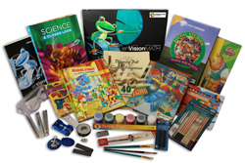
Connections Learning provides
Online and printed texts
Workbooks and manipulatives
Other materials (e.g., science kit and art supplies)
Notes:
Emphasize that families are sent everything they need after their registration is complete.
Although they have to provide their own general school supplies (paper, pens, additional printer cartridges), everything else:
Books,
Science kits,
Art and PE supplies
And more
Are sent to them at no costs
Some materials, such as books, are loaners, but we pay for return shipping at the end of the year.

Slide 9


















Leading Curriculum Partners
Notes:
Content is embedded in the lesson plans. For example, if they needed additional assessment (or practice taking certain State tests) teachers may use Study Island. If they need additional instruction, the may use SkillsTutor.

Slide 10
The Core and More
One of the largest course selections available from any virtual school.
Strong emphasis in the core subjects:
  Language arts
  Math
  Science
  Social studies
Variety of Electives:
  Chinese
  Spanish
  Juilliard
Notes:
Emphasize that we have a very wide selection of courses compared to many other schools. We really focus of the core courses, but we think it’s important to spark student’s interest in many other areas as well. Thus, we offer more than 50 electives in many subject areas. A partial list is on the next slide.

Slide 11

For Gifted Students, a Path to Success
The right challenge
  Developmentally appropriate
  Intellectually stimulating
  Accelerated pacing
Special gifted & talented courses
  Enrichment options to grade 2
  Grades 3-6 math, language arts, and science courses
Notes:
Developmentally appropriate yet intellectually stimulating content
Accelerated pacing Options for all grades
Grades K-2: Flexible placement, pacing, and instruction lets students progress according to their abilities
Grades 3-8: Differentiated math, language arts and science courses. Our Language arts program uses renowned Junior Great Books® series

Slide 12
Teachers
Who is the teacher? How can I reach them?
  Each Connections class has a dedicated Wisconsin Certified teacher leading the way, this teacher will be contacting you on the phone, web conference or webmail and available for help as needed. Your student (s) teacher will contact you before classes begin, introducing themselves and giving you instructions on how to reach them.
  Your teacher is your first point of contact if you have any problems, before calling ALAW administration or the Guidance Counselor, be sure to check with your teacher.
  Sometimes you will have more than one teacher, your
  ALAW teacher is always the first point of contact. They are
  up to date with ALAW policies, and have frequent contact
  with ALAW administration.

Slide 13
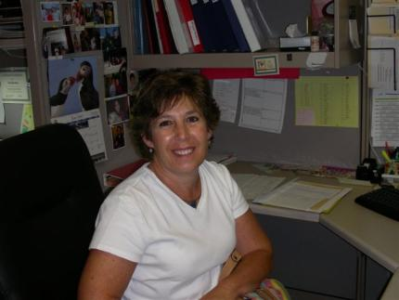
Teachers—The Connections Learning Difference
Highly qualified and caring
Wisconsin licensed
Online education experts
Unparalleled service
“Whenever he has a question or a problem his teachers work with him until he understands. Their guidance is so appreciated!”
Connections Learning Parent
Notes:
Highly qualified Wisconsin licensed educators
Experts in online education
Teachers have a close relationship with you and your student
Individual teacher or teachers assigned to each student
Subject-specialist teachers assigned for each core class in upper grades.

Slide 14
Connexus
Let’s take a look around Connexus to see the tools available to you and your child(ren).
Notes:
Hyperlink to Connexus tutorial.

Slide 15
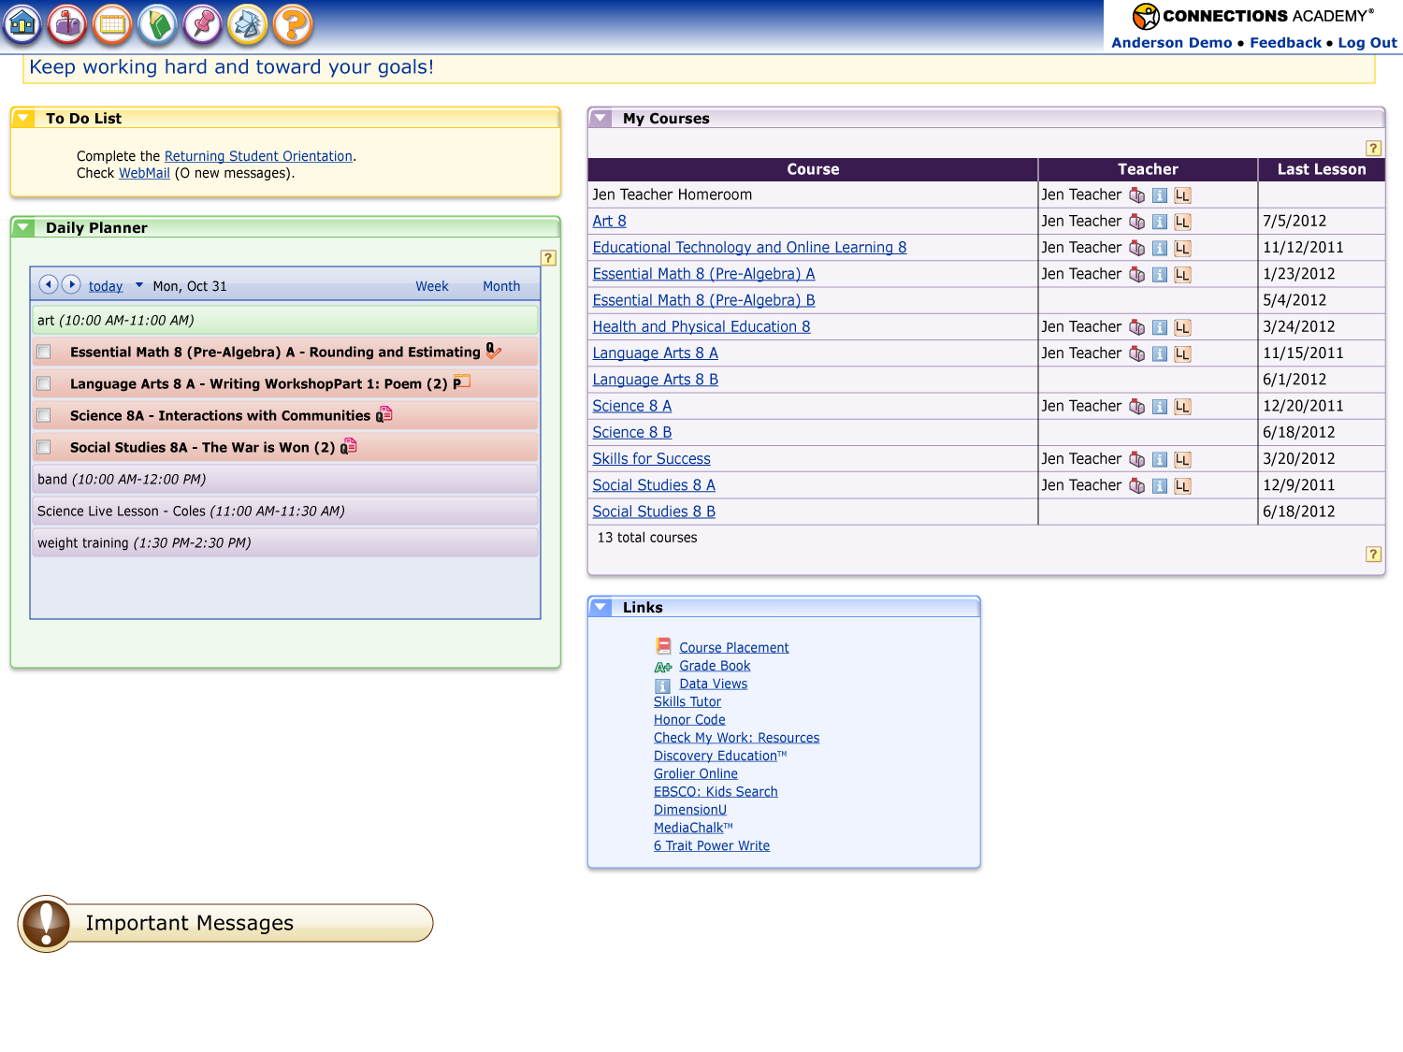
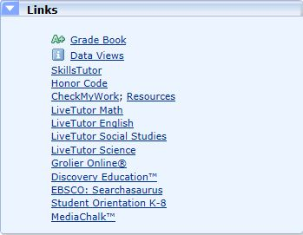
THE PLATFORM – CONNEXUS®
Education Management System
Notes:
This is the Dashboard for the student. Everything they need is here. In the Daily Planner they will find the lessons they need to complete today. You can schedule out the day using the calendar if you would like, this can help first time virtual school students as they learn to budget their time wisely.
My courses will take you to each course your student(s) is enrolled in.
In the Links section you will find all kinds of helpful tools for you as the caretaker and for the student. Everything from current grades, to LiveTutors to online learning tools.

Slide 16
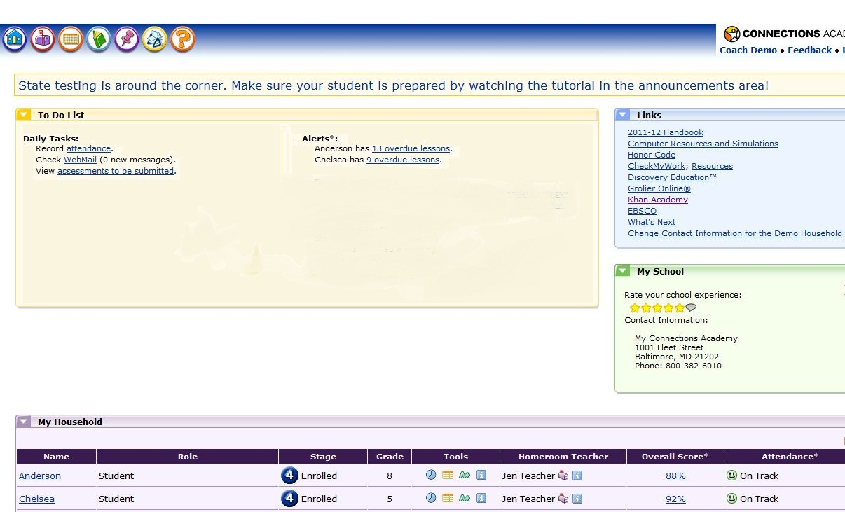
CONNEXUS® Learning Coach/Mentor View
Notes:
Your daily tasks will change each day, be sure to check your webmail for any messages from teachers. You can also see what assignments need to be completed today, this can help you as you are creating a daily schedule.
You will see there are alerts telling you about overdue lessons, a calendar is created when your student(s) is enrolled, this is done so they can stay on track on complete their class on time. When you see alerts for overdue lessons it means they are behind schedule. If you are concerned about this or would like to reset your calendar, please contact your ALAW teacher.
When you click on your student’s name you will be taken to the student dashboard. You will be able to see what your student(s) sees.

Slide 17
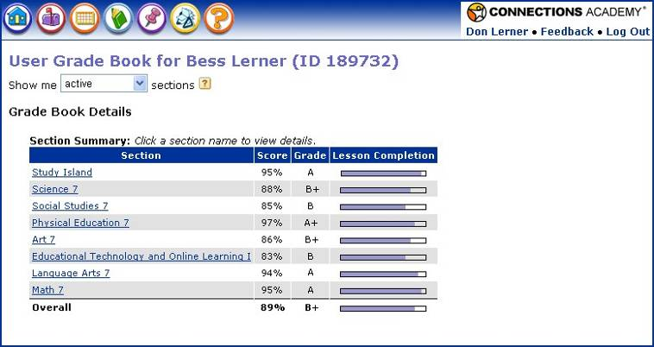
Grade Book: Continuous Reporting for Steady Progress
Track performance and progress in each course–grades available 24/7
Notes:
Unlike a traditional school where families might only see results on periodic report cards or progress reports, Connections Academy can see the most up-to-date results at any time. The grade book is available 24/7. You can see,
Grade so far
Percentage so far
Percentage of lessons completed
And class names are links. Click for more detail

Slide 18
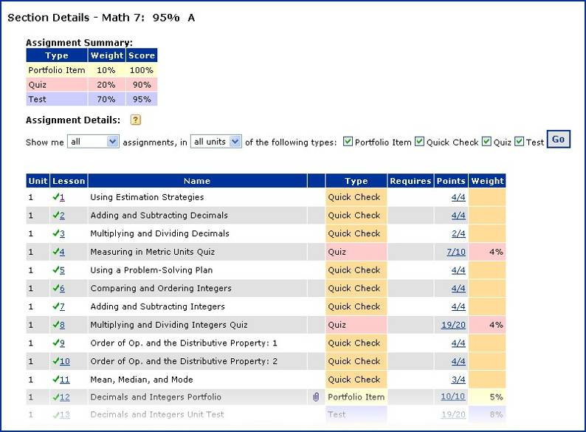
Details for Each Class
See results for each assignment as soon as it is graded
Notes:
This is the detail on one course in the Grade Book. You can see your child’s results as soon as your teacher inputs them.

Slide 19
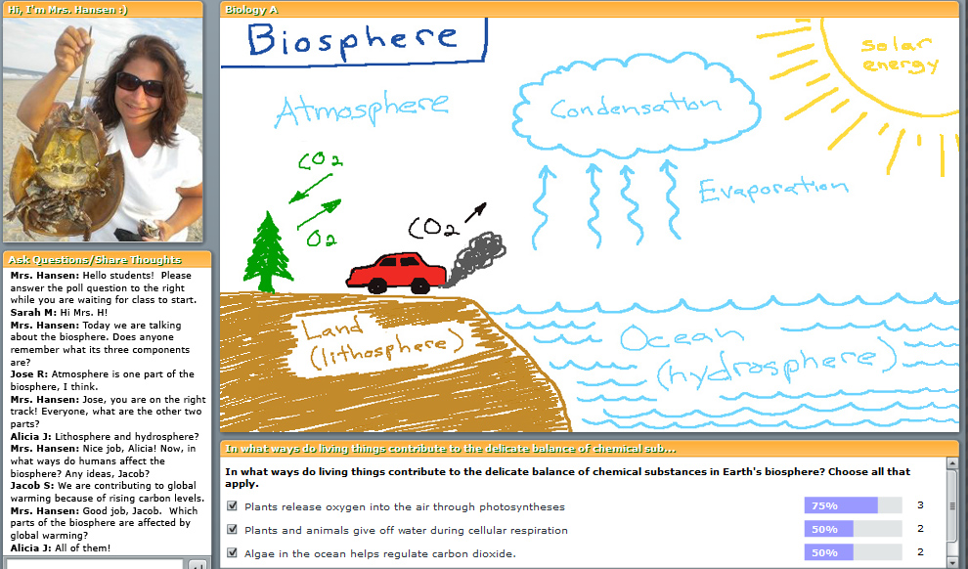
Engaging Live Instruction
Notes:
This is a screen shot showing one of our teachers doing a science live lesson for students. She has the option of using her web cam and microphone and can grant students microphone rights. There is a white board where she has drawn a picture showing elements of the Biosphere. See the chat pod where she is interacting with students. There is a Poll pod which she is using to check for understanding during the live instruction. This LiveLesson is also recorded so that students who can’t attend “live” can view it later. Students are encouraged to take notes during LiveLessons, and their attendance is recorded in the student’s log.

Slide 20

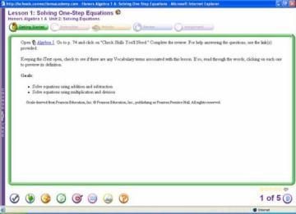
We Listen
We solicit ongoing feedback
Parent and student surveys with published results
Online five-star rating system all year long
  Rate each lesson
  Rate the overall school experience each day
  Provide comments

Slide 21

Parent FAQ’s

Slide 22
Parent FAQ’s
How do we keep attendance?
Is tutoring available?
How do we take course exams?
How do we do standardized testing?
How often will it be?
How involved should I be?
Are there any other parents I can talk to?

Slide 23
Attendance
Every day your student(s) makes progress in their coursework, they are attending school. This can be measured by time spent online with their class, reading “offline,” completing work in a workbook, science experiments, writing a paper, and much more.
Attendance is tracked through the use of an excel spreadsheet, you will need to record the attendance for each student in your home.

Slide 24

Tutoring
There is weekly live tutoring available for all of our Connections students.
Tutors are available to help with any questions or concerns students might have about their courses.

Slide 25

Course Exams
All Connections exams are online, non-proctored, and the results will be available immediately!

Slide 26
Standardized Tests
How do we do standardized testing? How often will it be?
  ALAW requires that students participate in Wisconsin State Standardized testing. We will coordinate these tests around the state.
  In addition your student will also need to take the STAR reading and math tests, these tests take place three times during the school year. Results are available immediately and can help us ensure your student(s) is on track and making progress.
  Kindergarten students are required to take the PALS tests at the beginning and end of the school year, this test will be administered in various locations throughout the state.
Notes:
STAR tests are proctored, online tests. These take approximately 30 minutes each. Results can be accessed immediately and growth can be measured. This is a great tool to measure progress and for setting learning goals.
The PALS tests helps us see what we need to do to help our Kindergarten students be prepared for school, how we can help them progress over the school year and see how your student has progressed.

Slide 27
Parent Involvement
How involved should I be?
  Our most successful students have a parent or support person who checks in with them, making sure they are staying on task and meeting goals.
  Some tips we have for parents:
    Set up a “study area” in your home, this place should be free of distraction, have all the necessary materials and be comfortable.
    Create a schedule.
    A daily routine is a recipe for success.
    Short breaks are ok.
    Set goals and follow up!

Slide 28

Questions?
CONNECTIONS LEARNING
Learning as Unique as You.

