Slide 1


PARENT Orientation

Slide 2
Welcome to the
Advanced Learning Academy!
Lets spend some time together getting familiar with the tools, teachers and feel of Virtual Schooling:
Answer some frequently asked questions
Give you a brief “snapshot” of the Learning Management System Brainhoney
Explain how to get in contact with us at ALAW so we can make this educational experience the best for you!

Slide 3
Frequently Asked Questions
How can I see my progress and grades?
Can I contact my teachers?
When do I have to finish my classes?
How do I request and take final exams?
How involved should my parent(s) be?
Are there standardized tests?
Are there any other parents/students I can talk to?

Slide 4
Materials and attendance
How do we receive materials for classes?
You will receive any textbooks for your classes shortly. Most classes have everything embedded within the course, there are a few that will have novels or textbooks as supplements.
What constitutes a student “attending” virtual school?
Every day you makes progress in your coursework, you are attending school. This can be measured by time spent online with their class, reading “offline,” science experiments, writing a paper, and much more.
While the courses are self-paced and flexible, we strongly encourage you to work on your courses every day. Minimum requirements require you to login and make progress in each course at least every five days.
.

Slide 5
Teachers
BYU-IS classes are lead by Wisconsin Certified Teachers. Teachers will meet with you using web conferences (Adobe Connect) or email.
You will have several different teachers as there are different teachers for each course in high school.
Teachers will have web conferences with you at least one to two times each semester. This school year, several classes will also include live lessons and learning labs each week.
Your teacher should respond within 24 hours (not including holidays or weekends), they have flexible schedules, and office hours including hours outside of the “traditional” school hours of 8:00-4:00pm

Slide 6
Is help available?
Most BYU-IS classes will include live lessons, face to face web conferences with your teachers and access to live tutoring.
You can contact BYU tutors online at www.is.byu.edu to schedule an appointment or send an email!
Live Lessons will be guided by your instructor, they will communicate the days/times for thsese with you ahead of time.
As always, you can contact the ALAW Program Coordinator with any questions you may have, we are here to help you have the best educational experience possible!

Slide 7

Brainhoney
BYU-Independent study

Slide 8
What is brainhoney?
Brainhoney is the website you will use to access your courses. All of your BYU-Independent Study courses will be located in one spot and are available 24/7.
To access your courses go to: www.alaw.brainhoney.com and enter your username and login information.

Slide 9
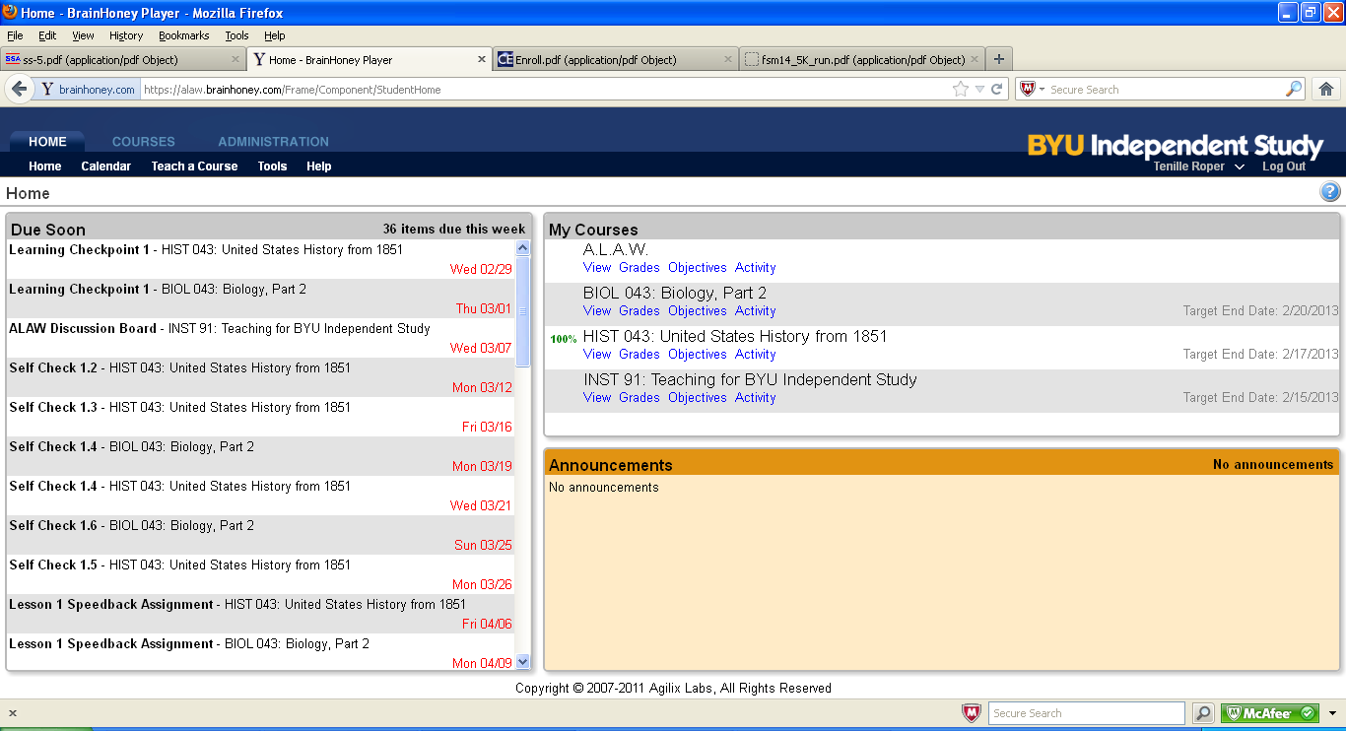
Homepage
Assignments Due Soon
Your Courses
Announcements From Your Teachers
Notes:
You can see the assignments that are due, what assignments may be overdue, grades, progress and even see the content of your lessons.

Slide 10
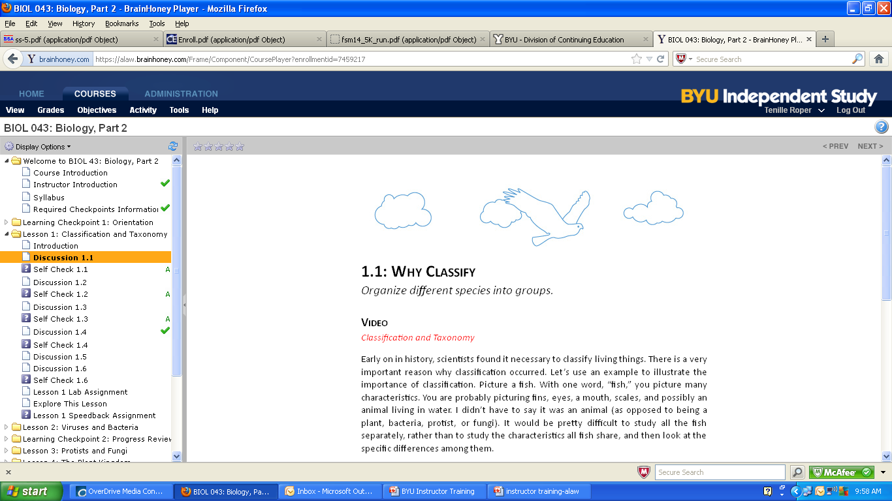
Lessons
Notes:
This is what a student lesson looks like, you can see the course material, what lessons have been completed, and what grades were earned.

Slide 11
Speedbacks, Self Checks and Finals
Self Checks: Self Checks are little quizzes throughout your lesson to check for understanding. You can take these quizzes as many times as you’d like as they do not count towards your final grade. Notes and books are allowed.
Speeedback Assignments : Speedback Assignments are located at the end of each lesson. They are tests that cover the material in your lesson. You can use books and notes during these tests, they do count towards your final grade, Speedbacks can be retaken 2 times, but must be reset by your instructor.
Final Exam: The final exam is the only test in the course where you can not use notes or books. The final exam is proctored, meaning you will setup a time to meet with your instructor online and take your test. You will need access to the internet and a webcam for the duration of the test. You must pass your final exam with a 60% or higher to pass your course. Finals can be retaken 2 times, but must be reset by your instructor.

Slide 12
Standardized tests
How do we do standardized testing? How often will it be?
ALAW requires that students participate in Wisconsin State Standardized testing. We will coordinate these tests around the state and come to a location convenient to you. State standardized testing will be in each Fall.
In addition you will also need to take the STAR reading and math tests, these tests take place three times during the school year. Results are available immediately and can help us ensure you are on track ☺

Slide 13
Parent Involvement
How involved should my parents be?
Our most successful students have a parent or support person who checks in with them, making sure they are staying on task and meeting goals.
Some tips we have for parents:
    Set up a “study area” in your home, this place should be free of distraction, have all the necessary materials and be comfortable.
    Create a schedule.
    A daily routine is a recipe for success.
    Short breaks are ok.
    Set goals and follow up!

Slide 14
Want to be More Involved?
The ALAW Parent Advisory Council is a group of parents who work together to make ALAW better. This volunteer organization works together with ALAW administration and the ALAW board to find ways to improve the way students are educated, how they interact with each other, create new field trips and much more!
We are looking for parents who want to be more involved in their student(s) educational experience.
Please contact us to talk about this opportunity!

Slide 15
Have a great year!
Advanced Learning Academy of Wisconsin
1050 E. Woodland Ave.
Barron, WI 54812
(715) 537-5627 x.133
We are here to help!

